Slide 1
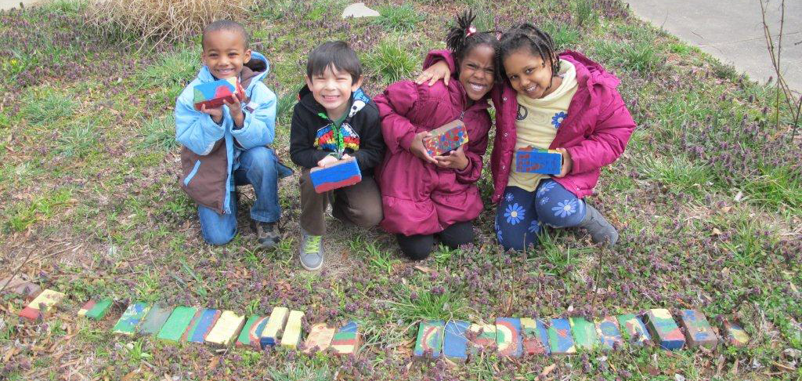

Maryland Green Schools Program

Slide 2

PROGRAMS
Why Should Schools become MD Green Schools?
  It meets the requirements of the law:
  Chesapeake Bay Watershed Agreement
    1. Environmental Literacy
    2. Student Outcome (MWEE: Meaningful Watershed Educational Experience)
    3. Sustainable Schools
  Code of Maryland Regulation 13A.04.17
    Comprehensive multidisciplinary program of environmental education in every school system
Academic achievement
Connection to other state/county requirements: STEM, NGSS, C3, College Career Ready, E-Lit
Recognition at the state, county, and school-wide levels + Good Public Relations
Interaction with Nature, while developing environmental stewardship
Health effects on Social, Emotional, Cognitive and Physical Development
Development of a 21st Century Workforce
Operating Cost Savings: Lower Energy/Water/Waste disposal bills
  Creating future Environmental Leaders
Notes:
Why is this program beneficial for schools?

Slide 3
Application Breakdown:
1) INFORMATION
2) DOCUMENTATION
1. Curriculum and Instruction
    1.1. Environmental Issue Instruction
    1.2. Professional Development
    1.3. School-Wide Environmental Behavior Changes (not required)
    1.4. Celebration
2. Student-driven Sustainable Practices (Choose 4)
    2.1. Water Conservation/Pollution Prevention
    2.2. Energy Conservation
    2.3. Solid Waste Reduction
    2.4. Habitat Restoration
    2.5. Structures for Environmental Learning
    2.6. Responsible Transportation
    2.7. Healthy School Environment
3. Community Partnerships, Awards, and Special Recognition:
    3.1. Community Partnerships
    3.2. Awards and Recognition (not required)

Slide 4
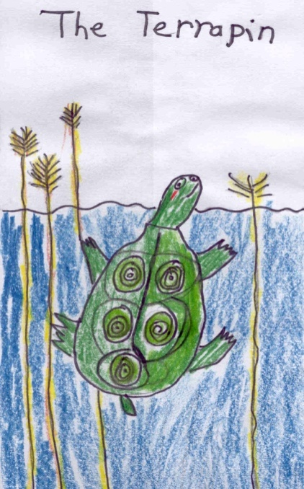
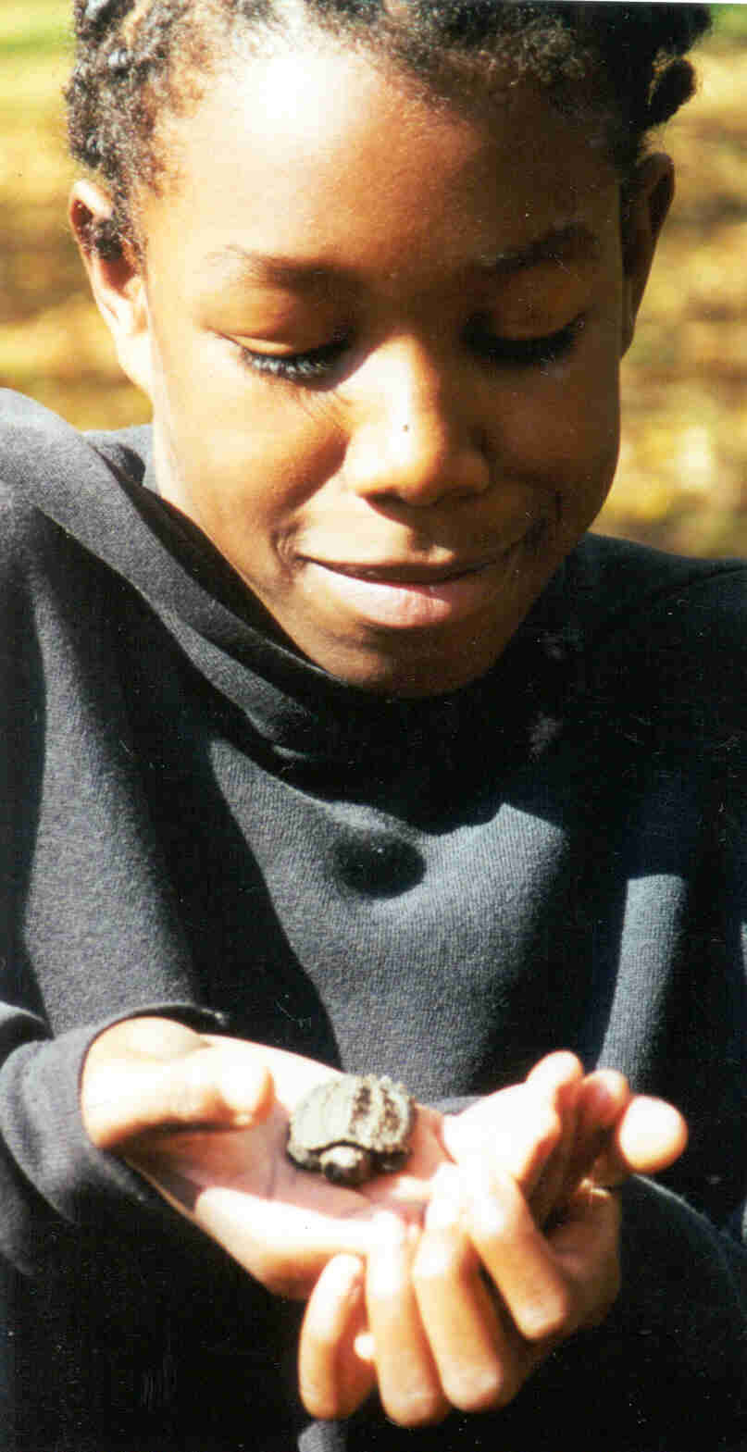
1.1. Environmental Issue Instruction
Instruction in all grades (embedded in science curriculum)
Possibly organize with a chart listing lessons by subject area and grade
Grade | Environmental Instruction
1 | Art recycling project, present to another class
2 | Decorating ‘Water Off” signs, creating a recycling dance
3 | Conserving water lessons; “Lights out” leader
The baseline is to have instruction in all grades. A stronger
application would include all grades, multiple subjects
(as shown above)
Notes:
Baseline is all grades. The next level of achievement is all grades multiple subjects

Slide 5
1.2. Professional Development
1.2.1. All staff is aware of the Green School application process
Whole staff presentation on Maryland Green Schools Program provided by a Green Center/Green Leader (Gerrie)
Must keep copy of agenda showing Green Schools
Must keep scanned copy of the sign-in sheet

Slide 6
1.2. Professional Development
At least 10% of teachers have participated in EE PD
in the past 4 years
Information should include dates, length of time, teachers’ names, grade levels, and numbers of teachers.
MAEOE Conference
Environmental education workshops. For example:
  Kindergarten MEWEE field trip training, Youth Environmental Action Summit Mentor Training (Offered by the Ward Museum - $150/1 CPD credit). Also, Project WET, Project Wild, Project Learning Tree, Flying Wild.
Environmental speakers presenting P.D. (not just info sessions) at staff meetings or workshops (NOT at school wide assemblies with students)
Environmental Education focused webinars
Bachelor’s or other degrees in Environmental Science
MAEOE Environmental Educator Certification
Notes:
NEW THIS YEAR​­ All schools (new AND recertifying) can use Professional Development from the past 4 years.

Slide 7
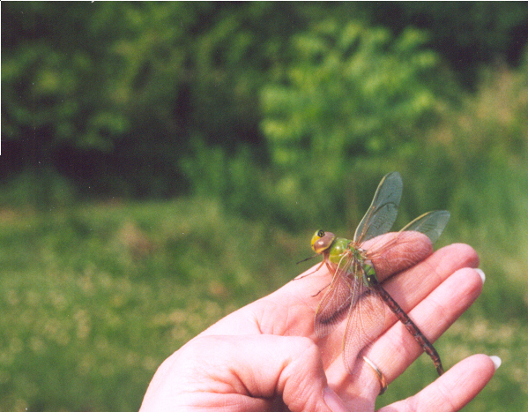
1.3. School-Wide Environmental Behavior Changes
Optional
NON-STUDENT driven Sustainable Practices
Examples:
  Installation of energy efficient lighting
  Staff carpooling or public transportation incentive program
  Reduction of impervious surfaces (blacktop, concrete) in the schoolyard
  Teachers using green cleaners in classrooms
  Installation of solar panels

Slide 8
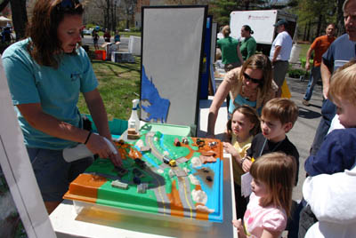
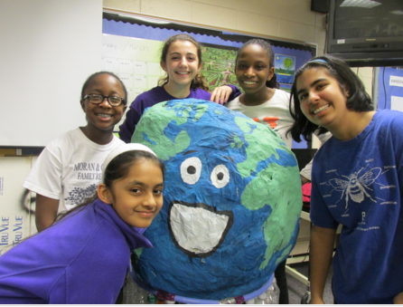
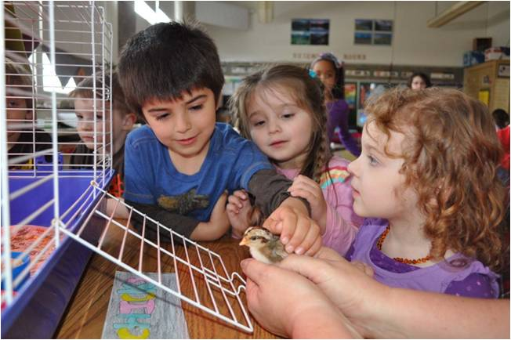
1.4. Celebration
School wide appreciation of the efforts and achievements of teachers and students
Public events that involve the school and community
The school shows off its sustainable activities
Ideas include: Field Day, parades, etc. (take an existing activity &
make it Green School themed) – Choices "return to home school" celebrations. Make signs for a refillable water station - provide or have students bring water bottles. Post information on Green Schools.
Notes:
After hours is ok, Demonstrate how your school community celebrates being green.

Slide 9
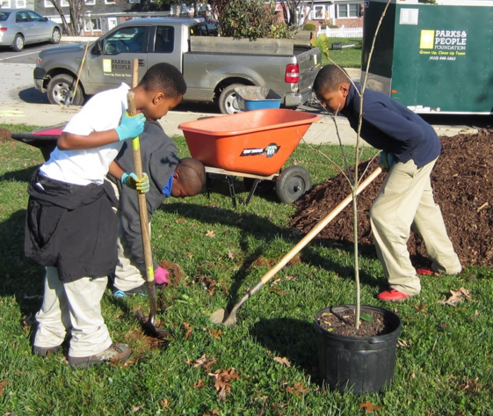
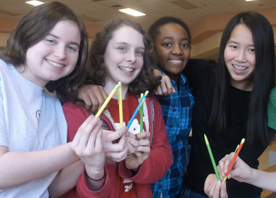
2. Sustainable Practices
Choose 4 of 7 practices; 2 activities per chosen category
8 TOTAL activities over the two-year period
Water Conservation/Pollution Prevention
Energy Conservation
Solid Waste Reduction
Habitat Restoration
Outdoor Structures for Learning
Responsible Transportation
Healthy School Environment
Student Involvement Required!
Notes:
Encourage to have more than 2

Slide 10
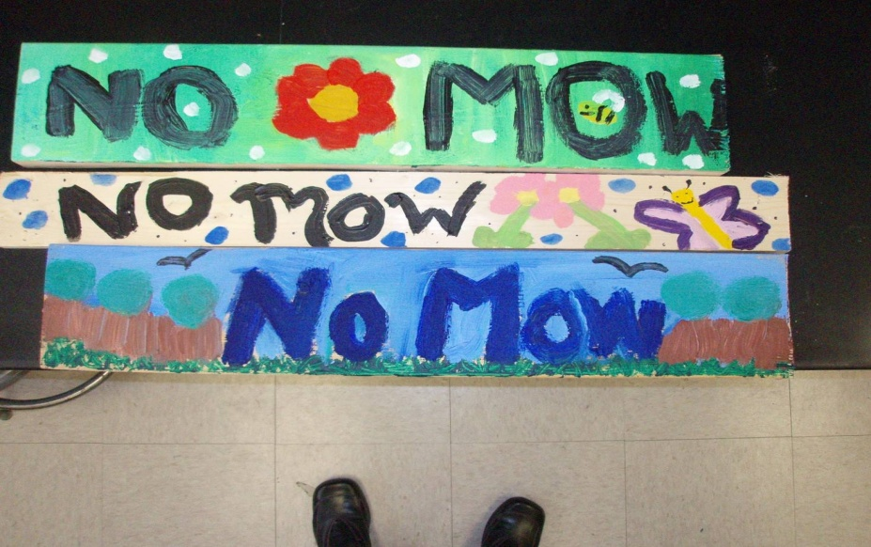
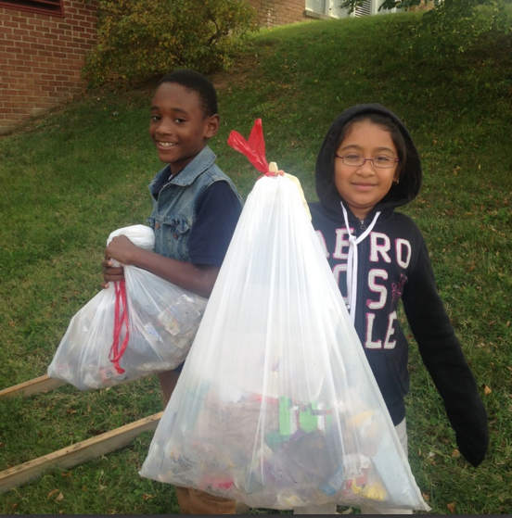
2.1. Water Conservation/Pollution Prevention
Rain gardens and other erosion
control measures
Students do a litter clean-up and learn about protecting the waterways. (Think about existing field trips such as to Assateague, Baltimore Aquarium, Delmarva Discovery Zone, Ward Museum, 3rd Grade LEAF field trip, Salisbury Zoo, and Hazel Outdoor Discovery Center with Gerrie) – just as long as the “theme” is protecting water quality.
Assembly by water treatment plant, followed
by student presentation to another grade level,
which then creates “Turn Water Off” signs for school water fountains and sinks.
Notes:
Tree plantings have many benefits including stormwater management and erosion control.
g
Middle and high school students can teach elementary students and parents how to plant and maintain.
Some schools label the native trees, shrubs, and the troublesome invasive plants on their campus.
“No-Mow” zones, as well as other outdoor projects may be used as extensions of classroom learning.

Slide 11

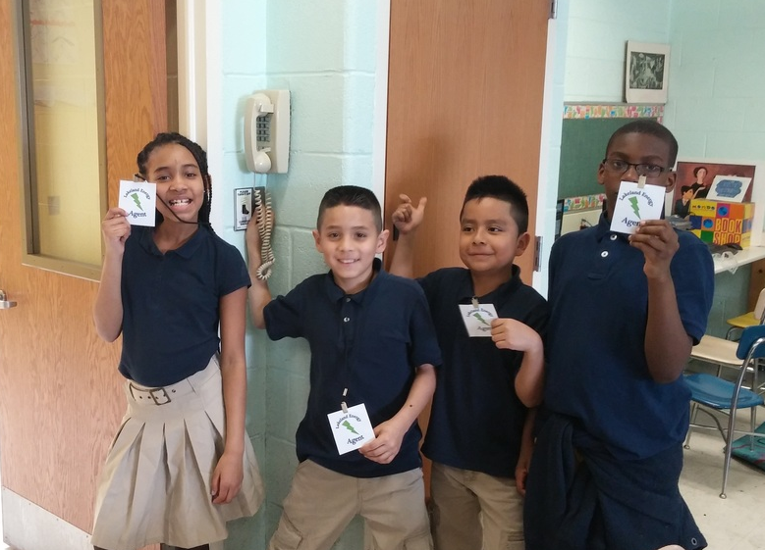
2.2 Energy Conservation
Student-made reminders to turn off the lights, with a classroom “Lights Out” leader
Students plant donated native trees to shade the building
Morning announcements/reminders/awards program for energy conservation
Use natural light and close blinds/curtains at end of day
Students promote actions to reduce ‘phantom’ energy loss: Make this a student classroom job to turn off smart boards and computers at day’s end
Host an energy company assembly to discuss ways students can help at school and at home*
Participating schools: 5th Grade utilizes DPL’s free Energy Conservation program
Notes:
*Choptank Electric has both an Energy Program Coordinator and resource kits for students.
The U.S. Department of energy says that on average 25% of energy use in schools is unnecessary. On average, Green Schools use 33% less energy than conventional schools
Poster competition to advertise saving energy, Teacher turn on half the lights, Introduce task lighting for teachers, turn off overhead lighting,“Delamping”– removing half the bulbs (MS), Set all computers, copiers, printers in energy saving mode, User education campaigns to turn off lights and devices, Compare the energy use of this school with others (per square foot), Obtain energy cost data about this facility., Inspect and calibrate thermostats, Remove chiller units from drinking fountains, Insulate all piping, Replace inefficient lighting with T-8, compact fluorescents, and metal halide fixtures, Close curtains and blinds at the end of the school day, Enable complete power down functions on computers, Do an energy assembly –discuss home and school energy saving tips, Student “energy police” –sticker system to remind users of turning off lights and equipment, Morning announcements/reminders/awards program
Energy fair, Use of natural lighting, Classroom energy monitor team, Invite a power company speaker, Do an energy survey – how many devices, what kind
Energy conservation hall display

Slide 12
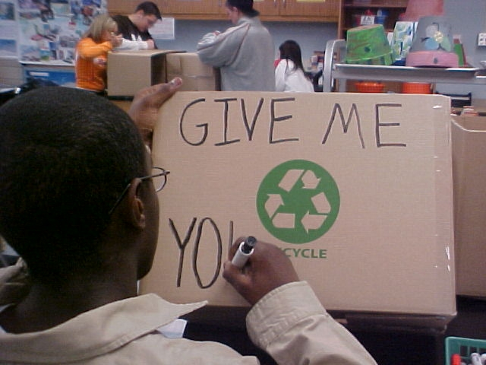
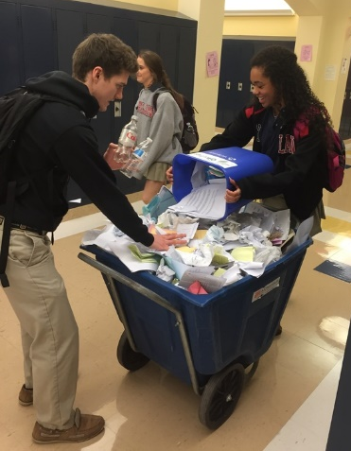
2.3 Solid Waste Reduction
Students organize a recycling drive for ink cartridges, old cell phones, markers, juice pouches, etc.
Students plan an indoor/outdoor clean-up day at school, as a follow-up to existing field trips, such as Assateague, Baltimore Aquarium, Delmarva Discovery Zone, Ward Museum, 3rd grade LEAF field trip, Salisbury Zoo, and Hazel Outdoor Discovery Center with Gerrie) – So long as the “theme” is solid waste reduction
Younger students teach older students about the importance of recycling
Students participate in no-waste lunch days
Staff uses One Note for all correspondence
Students create labels for recycling stations
Parent Newsletter is distributed through email
Notes:
Examples of what some schools have accomplished for this BMP
Terracycle, Crayola recycling
Older student mentor younger, Federal Hill had a fifth assigned to each classroom and they were in charged about teaching the kids about recycling

Slide 13
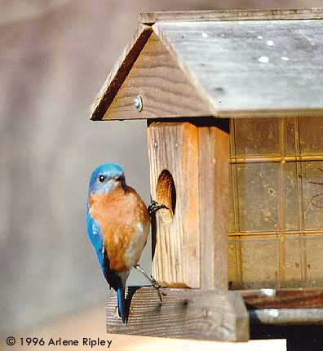
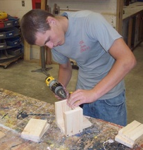
2.4 Habitat Restoration
Invite local business/watershed organizations to help!
Students plant native trees/shrubs/perennials, as donated by DNR, MD Extension Office or local businesses (This can be as a beautification project for the school).
Students create a bird/butterfly/bat habitat area with food, shelter and water sources. (This could include utilizing community partners such as 4H or MD Extension Office to build shelters. Gerrie can teach a lesson on making bird feeders from recycled materials).
Focus of STREAM or other after-school program's action project
Notes:
Schoolyard habitat restoration projects could involve:
- Planting native trees, shrubs, and perennials for food and cover
- Erecting bird, butterfly, or bat boxes
- Removing turf or impervious paving and introducing native plants
- Constructing brush piles or saving snags and downed tree logs
MAEOE’s Schoolyard Habitat Partnership Program and the Chesapeake Bay Trust can be good partners.
Invite parents, local businesses, and watershed organizations to join in and help.

Slide 14
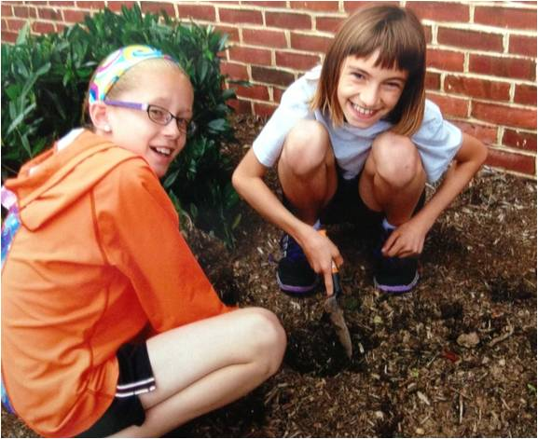
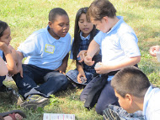
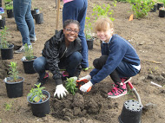
2.5 Structures for Environmental Learning
Students use structures for environmental learning regularly
Students make interpretation signs for bird, bat, and butterfly boxes
Students plan & use (or improve) Outdoor Learning Gardens
Students create native plant ID tags
Students design and build a school garden
Working with the Art teacher, students create outdoor art out of recycled materials: kindness stones, recycled pavers, sculptures
Notes:
Structures might include:
Informational signage
Tree/plant identification
Wildlife viewing blinds
Outdoor classrooms (permanently installed or moveable “bucket seats”)
Birdhouses
Bathouses, etc.

Slide 15
2.6 Responsible Transportation
Students plan carpooling programs/Teachers utilize carpooling
Students create signage or a brochure for no-idle zones (car riders & buses)
Students analyze school transportation issues /carbon footprint
Students routinely go on walking field trips, use public transportation, or walk to school
Students attend the annual “Walk to School” day in Oct. or the Bike to School day in May
Choices - "Return to Home School" event, where students received bikes from a community organization, street was closed down for the celebration.
Notes:
Projects might include:
Raingardens to slow down and bio-retain parking lot runoff
Pervious paving
Carpool plans
Bicycle safety programs and bike lanes
Bike to School Day, Wed. May 4, 2016

Slide 16
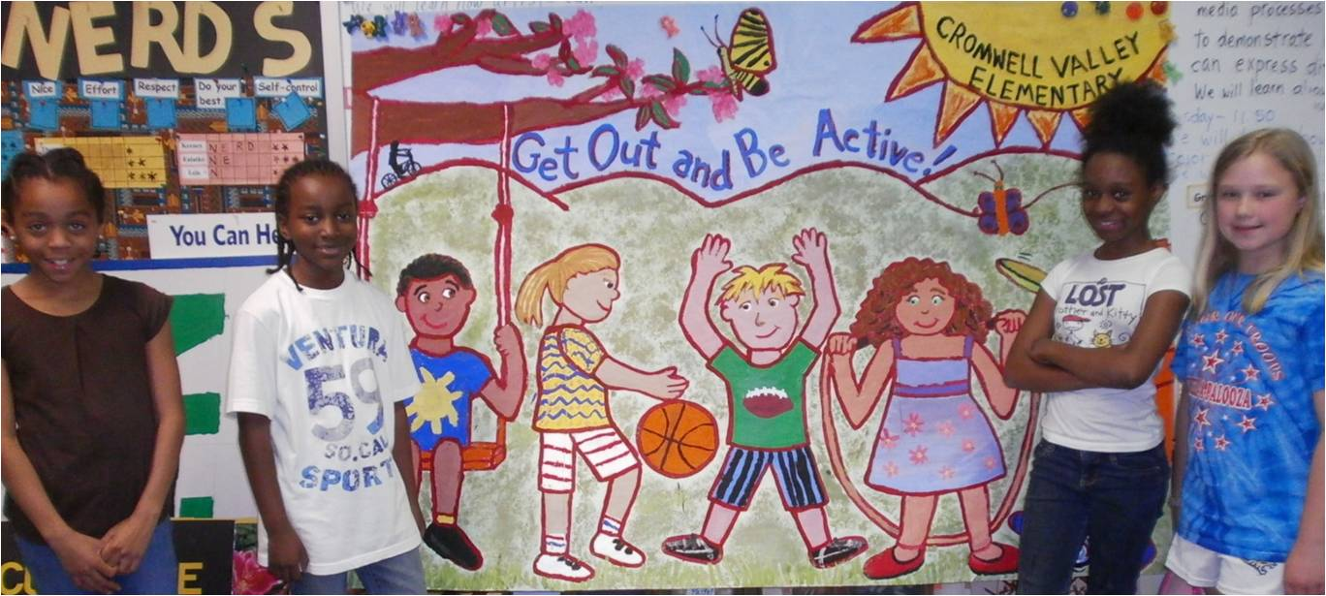
2.7 Healthy School Environment
Use non-toxic “Green” Cleaners
Students promote the use of indoor plants (consider having a grade level petition administration for these as gifts during Teacher Appreciation Week)
Students participate in healthy local foods programs: Free Breakfast and lunch; Free Fruit & Vegetable snack program
Students grow and eat produce from a school garden
Students organize an outdoor running/Cross Country or other health club that utilizes the school grounds and encourages the students to spend time outdoors.
Students create a mini poster campaign to encourage healthy eating choices
Notes:
Use non toxic “Green” Cleaners, Advocate for low/no perfumes, Add indoor plants, Use walk-off mats at entrances to reduce dirt, Check air flow and filters, Open windows when appropriate, No Idle Zones for cars and buses, Integrated Pest Management Plan
5K runs in of themselves are not necessarily green related

Slide 17
Ways to make this a student-led initiative
Place students from all grade levels on the Green School committee to promote buy-in and leadership. (they do not have to attend meetings; just need to be involved.)
Utilize the artists in your school to create brochures, posters, etc.

Slide 18
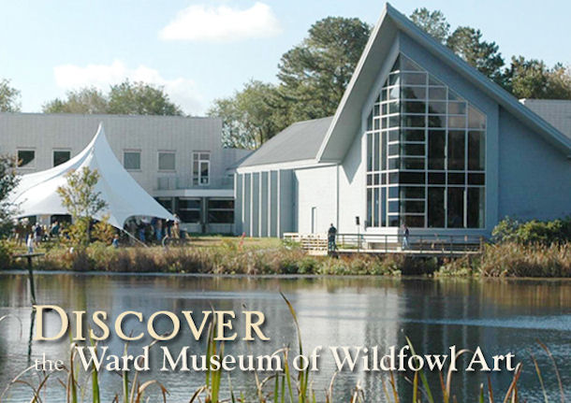
3.1 Community Partnerships
Parents and PTA● MD Green Centers ●MD Green Leaders ●Community Centers
● Salisbury University
● Choptank Electric or DPL
●Chesapeake Bay Trust● MD DNR, MDE, MSDE● UMD Cooperative Extension● Local garden clubs, businesses and organizations
Work with community partners for an off-site campus clean-up day, Earth Day activities, sign them up to be a guest speaker, they can help design a garden/habitat, etc.
Notes:
Examples:
A campus cleanup day, advertised to the community, with the local waste management agency
Bringing in a county recycling coordinator to speak to the staff
Working with a Master Gardener to design a habitat
Working with MD DNR on a grant to install a stream buffer

Slide 19

3.2 Awards and Special Recognition
Optional
Examples:
  “A” grade on recycling from the county
  Measureable energy savings
  LEED certified building
  Eco-schools silver award
Notes:
Awards or participated in advocacy initiatives supporting BMP or
Climate Change awareness, include a few sentences describing the activity, grade
level, number of students who participated and date

Slide 20

Documentation
Make sure that everything you say is backed up by documentation!
Caption every piece of documentation:
  date
  number of people involved (specific names of staff required for PD)
  description of activity
Examples of strong documentation:
  Photos of involved students (no posed pics)
  Dated student work/reflections
  dated correspondence (with student involvement proven if necessary)
  newspaper/newsletter articles reporting on a completed activity
  certificates/awards
  (for PD): dated agendas with sign-in sheets
  (for PD): dated certificates of completion/participation
  (for PD): dated email registrations/ confirmations of attendance
  Keep track of your data – ex. Pounds of recycled materials

Slide 21
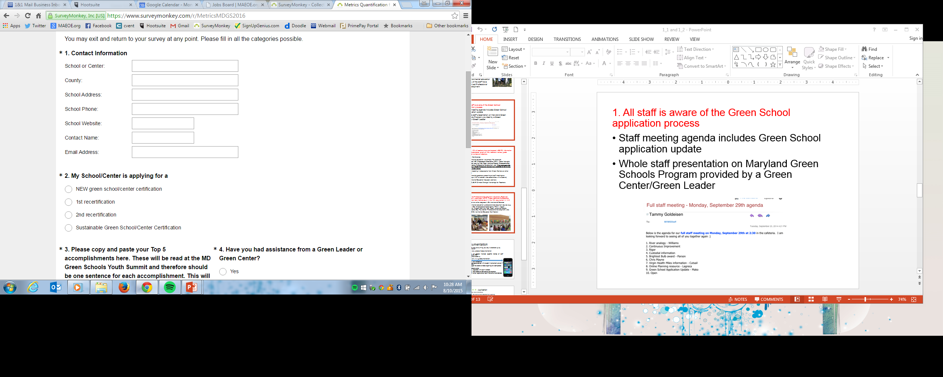
Metrics Collection
Required Survey Monkey Metrics Collection
Information needs to be inputted online (keep separate copy until end)
Paper copy not accepted
Instruction can be found: http://maeoe.org/wp-content/uploads/2014/10/Metrics_Survey.pdf

Slide 22


Timeline/Cost
Most common application type is a website (Gerrie can help with this)
Application includes actions over two years from September to June
File on-line (5-10 min process) “Intent to Apply” by approximately December 14th of Year 2 - $75 fee (non-refundable)
Applications are due approximately March 18th of Year 2
Application Review by MAEOE – End of March
Notification – by Earth Day
Youth Summit- Late May at Sandy Point State Park (May 30th 2019!)
Notes:
https://youtu.be/9vfVlSgKLcU

Slide 23
Local examples of applications
http://willardsgreen.weebly.com/
https://fpsgreenschool.weebly.com/
http://wisgreenschool.weebly.com/
https://fisgreenschool.weebly.com/
https://maeoe.org/green-schools-and-green-centers/green-schools-program/current-green-schools#wicomico-county

Slide 24
Local resources
http://hazeloutdoordiscoverycenter.org/ (contact Gerrie)
Choptank Electric: - Tom Tindle, Energy Program Coordinator
1-877-892-0001, ext. 8633
Kidsenergyzone.com
Delmarva Power: 5th grade only @ select schools!
FREE energy kit for each student + NGSS-aligned lessons http://www.delmarvaenergizeedu.com/index.html
Paleo Water Treatment Plant: Cori Cameron, Superintendent
4th & 5th grade field trips OR assemblies (as low as 2nd/3rd grade)
ccameron@Salisbury.md 410-548-3199

Slide 25
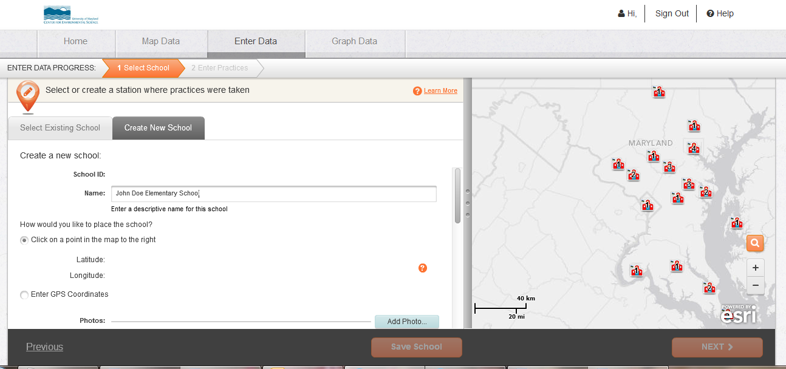
MASS FieldScope
Mid-Atlantic Sustainable Schools FieldScope
  Go to www.maeoe.org/fieldscope to find resources and directions

Slide 26
Supporting evidence
https://www.tandfonline.com/doi/full/10.1080/1533015X.2014.983658?scroll=top&needAccess=true
http://www.baltimoresustainability.org/wp-content/uploads/2017/08/Maryland-Green-Schools_FY18-presentation.pdf

